Slide 1
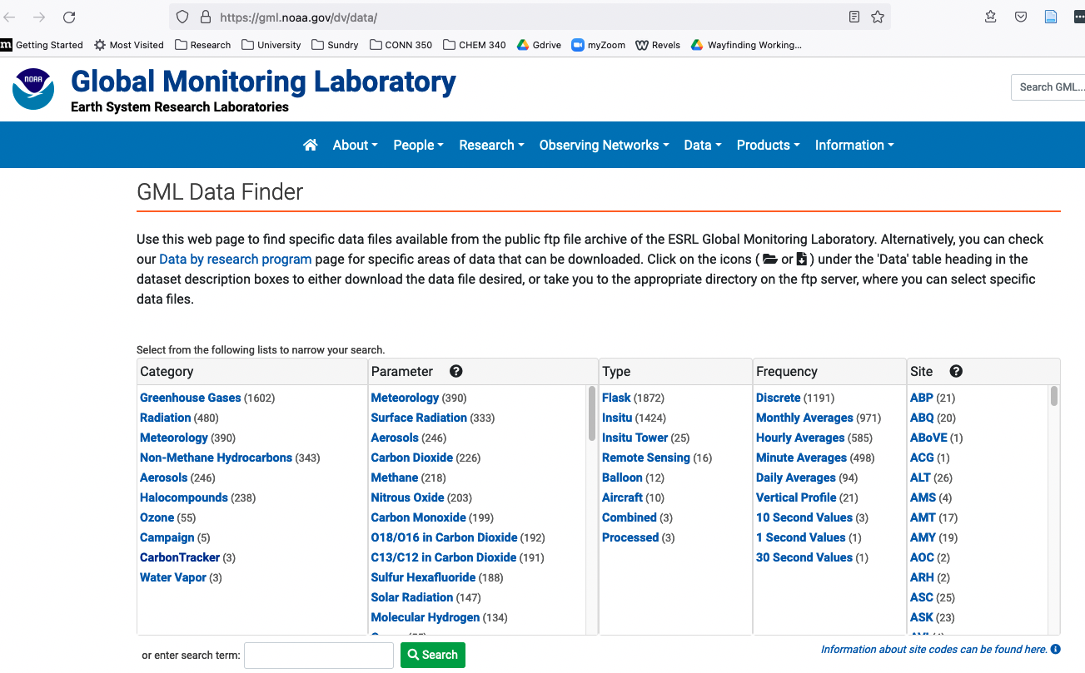
NOAA archive
https://gml.noaa.gov/dv/data/, Navigate to Meteorology, Hourly Averages, BRW
Data
Metadata

Slide 2
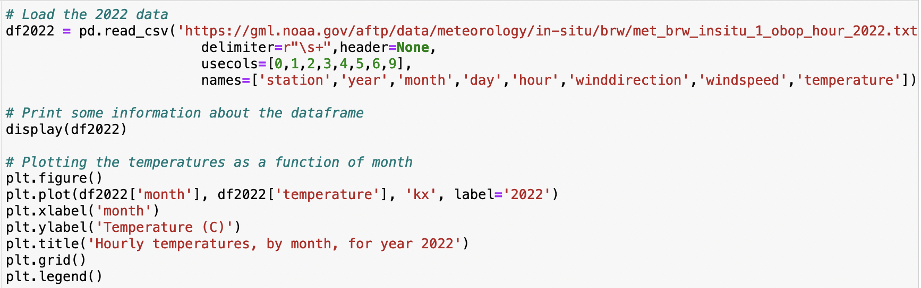
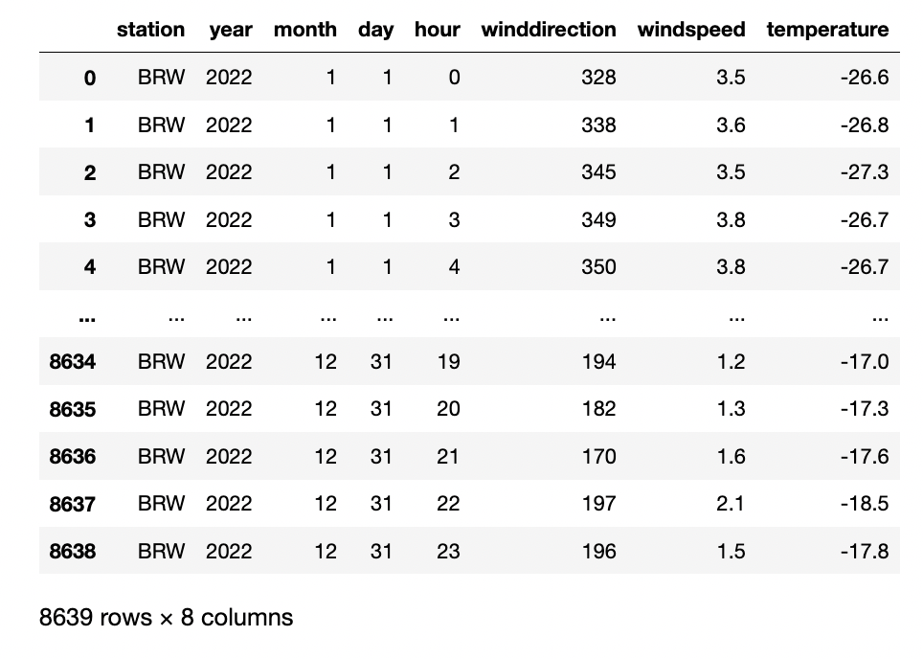
PANDAS loads and displays that kind of data as a dataframe

Slide 3
Python can graph selected parts of the dataframe

Slide 4
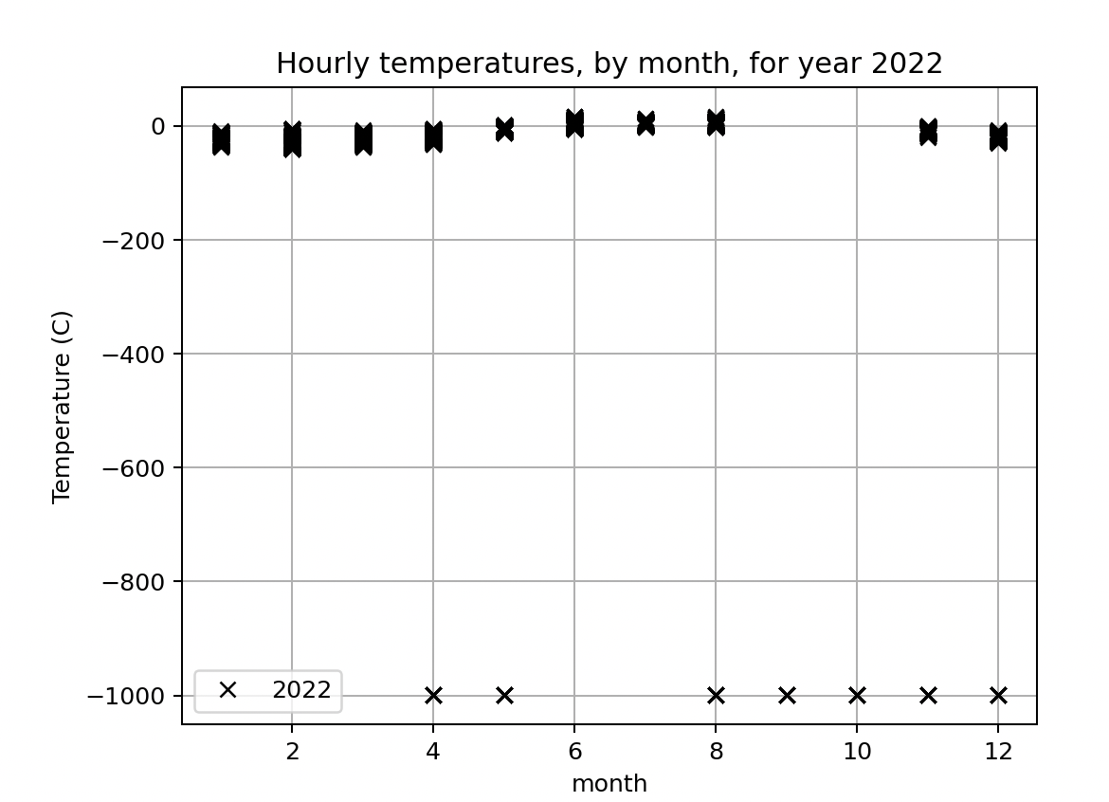
What you download generally needs some quality control

Slide 5
What you download generally needs some quality control
Good data
Bad data

Slide 6
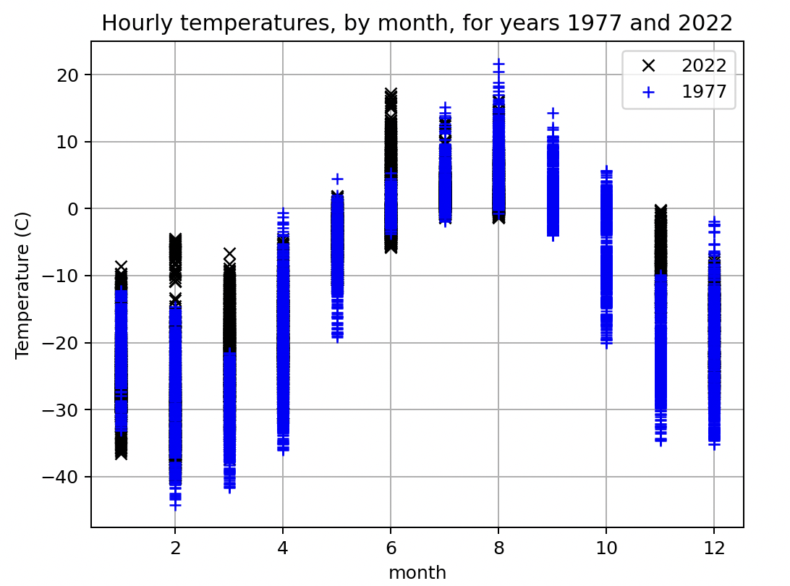
What you download generally needs some quality control
Good data
Bad data

Slide 7
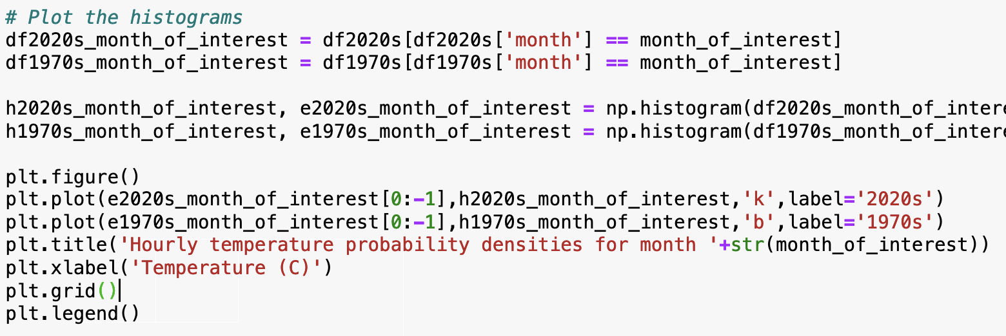
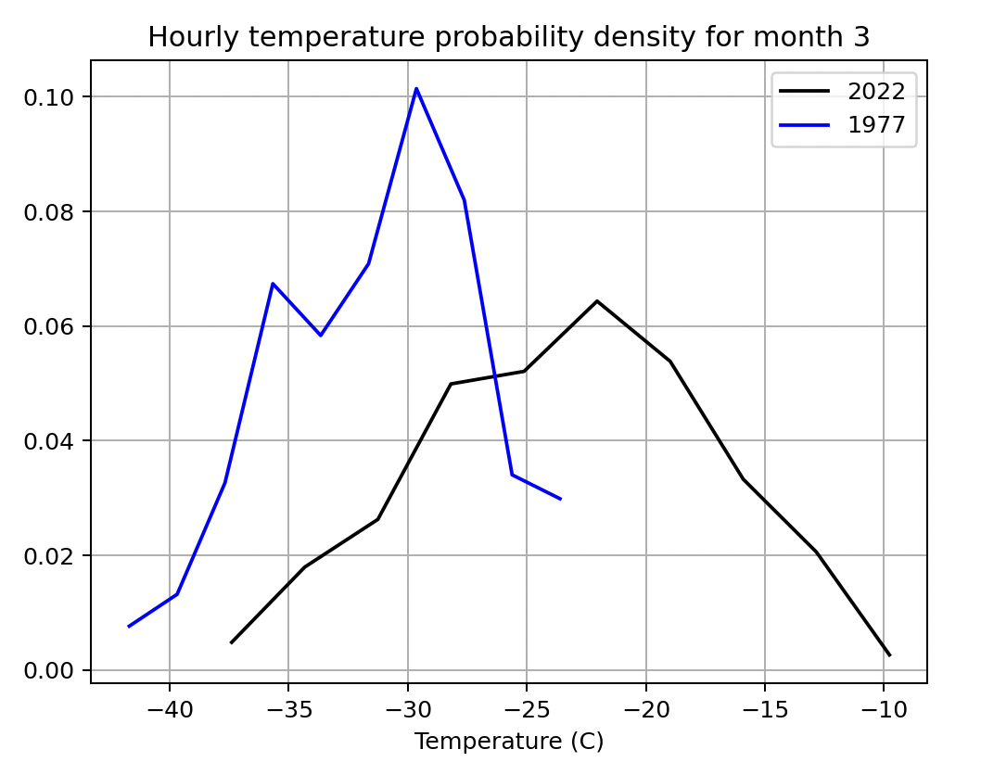
Once you have got rid of the bad data, you can get probability densities (histograms)

Slide 8
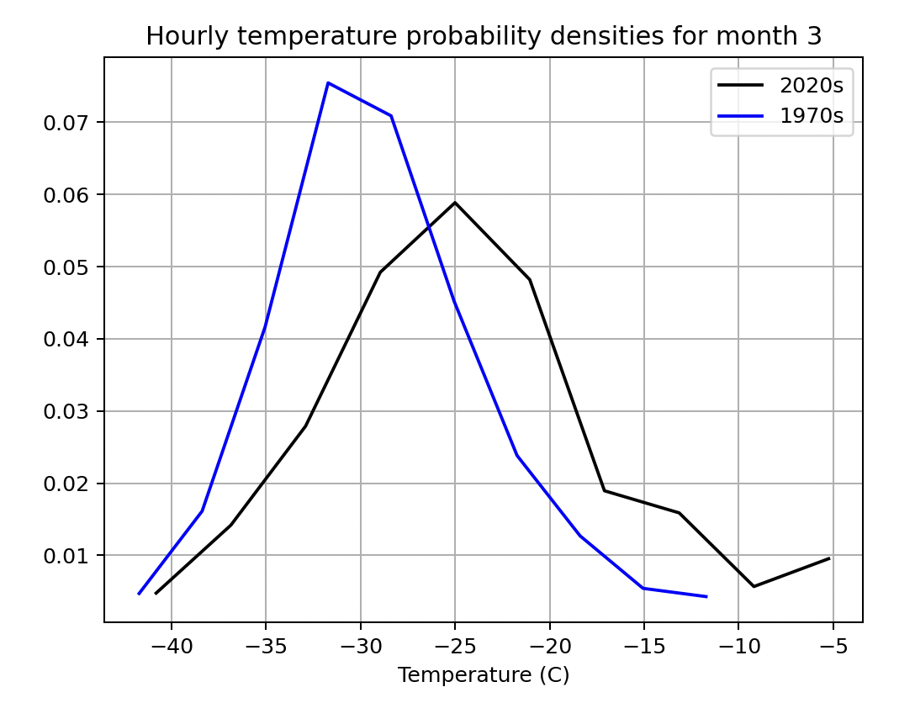
Combining probability densities over multiple years tends to give a more reliable picture
1-year datasets
3-year datasets

Slide 9
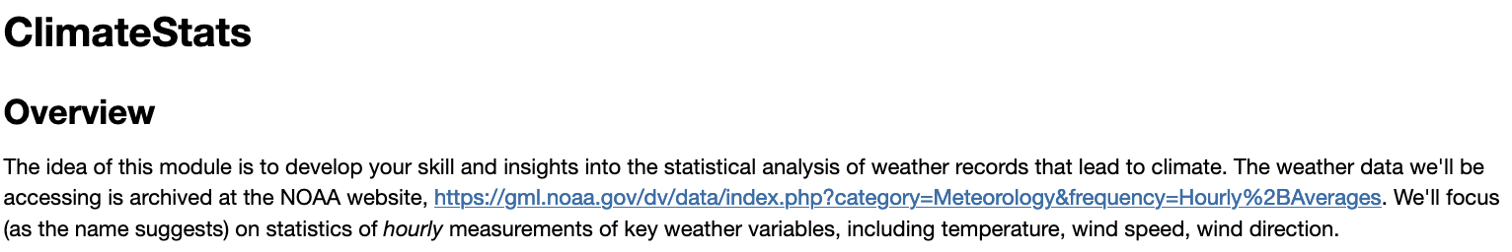
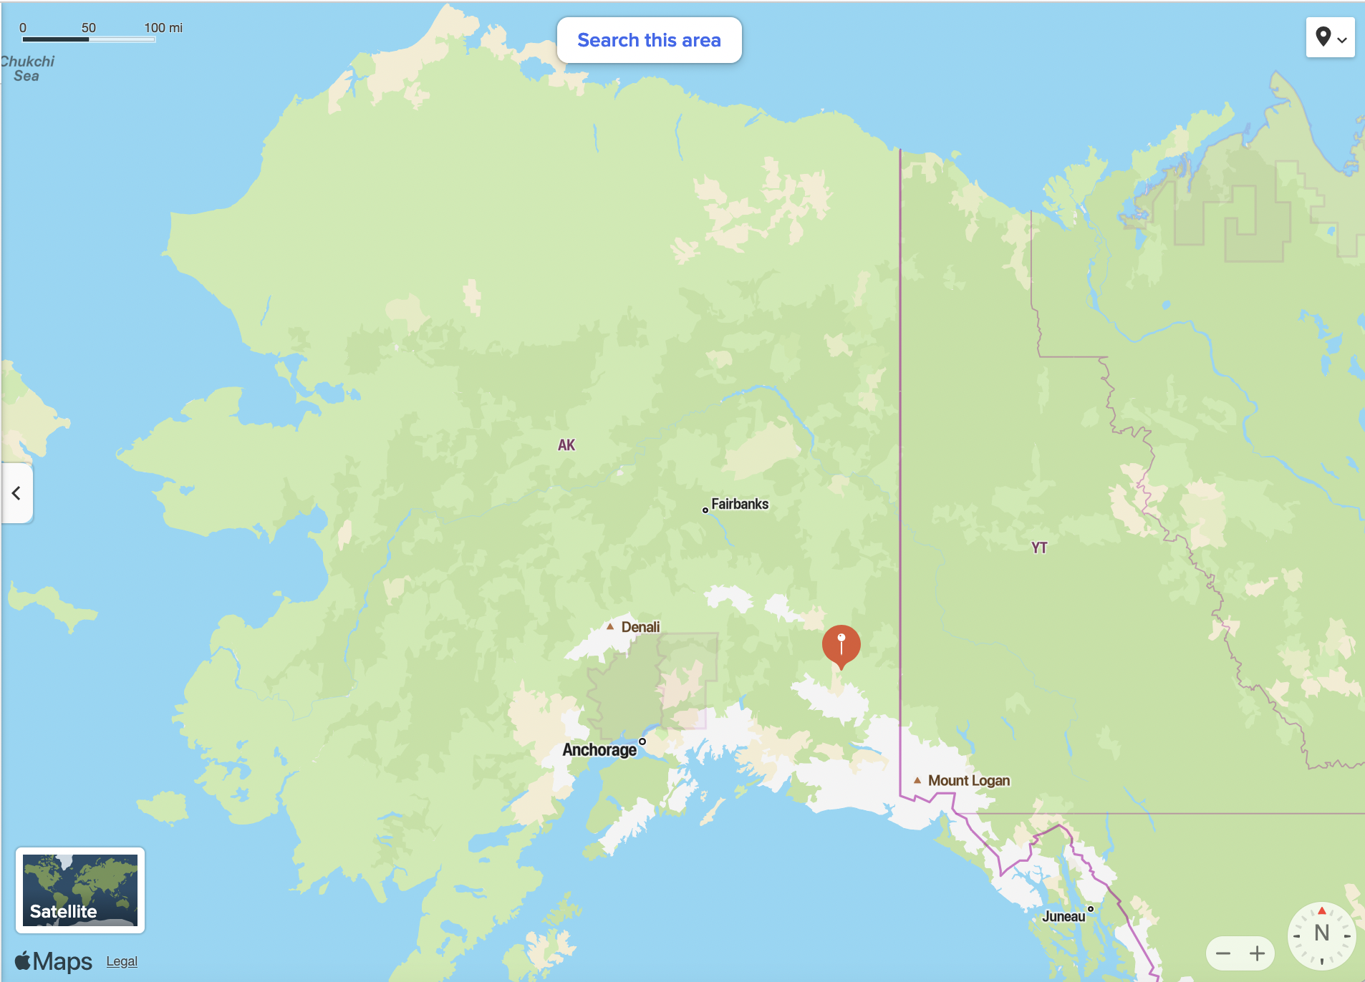
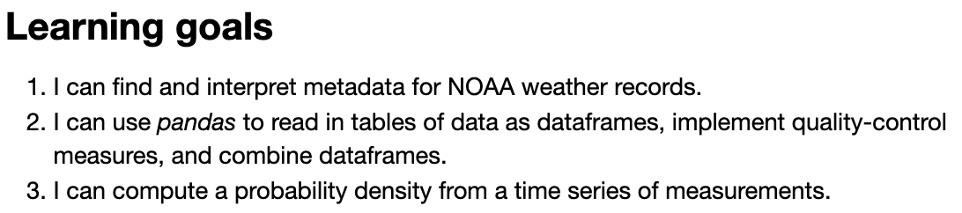
The CGI associated with this

